Slide 1
Battle of the Neighbourhoods
By Bishal Khatiwada

Slide 2
PROBLEM
Where should I set up a new park in Toronto, so as to attract the maximum number of people?

Slide 3
DATA
Parks and other spots sorted neighbourhood wise
Details of the Neighbourhood i.e. latitude and longitude from Wikipedia using BeautifulSoup
Data on Toronto Neighbourhoods from FOURSQUARE API using the latitude and longitude.

Slide 4
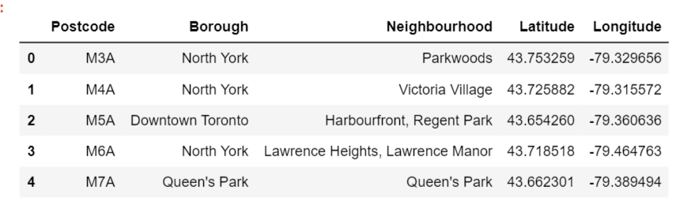
Data on the neighborhoods from Wikipedia Using Beautiful Soup
Latitude and Longitude using the Geospatial data

Slide 5
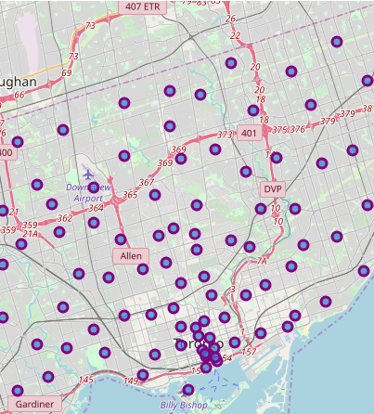
Visualization of the Neighbourhoods On the Toronto Map

Slide 6
WHAT NEXT?
Importing Data from FOURSQUARE
Applying KMeans Clustering after processing the Data

Slide 7
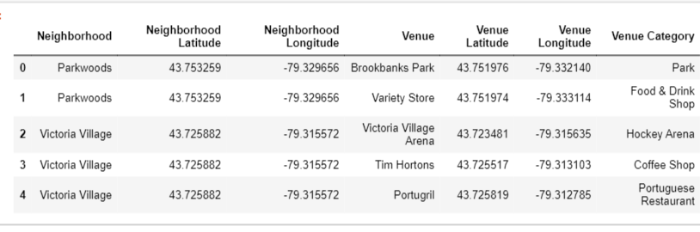
Here’s what the data from FOURSQUARE looks like

Slide 8
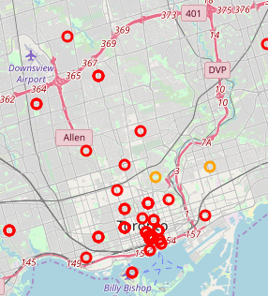
Visualization After K Means Clustering

Slide 9
Result
A park away from the shore might be beneficial as there is a density of similar parks towards the shore area

Slide 10
THANK YOU

